Slide 1
Through The Speculum
Smart Mirror -
Major Design Project Proposal
ECE 441
February 25, 2022

Slide 2



Team
Alan Palayil - B.S. Computer and Cybersecurity Engineering | Fabian Garcia - B.S. Computer Engineering | Gabriel Gutierrez - B.S. Electrical Engineering

Slide 3
Outline
Alternative project ideas
Our project
Objective
Hardware
Software
Challenges
Progress and goals

Slide 4


Alternative Ideas
Directional PV panels
Goal: Optimize the solar panels direction
Methods:
Follow a predetermined path
Will follow the suns East to West path
Find the location of highest intensity
Convert the skies brightness into a heat map (useful for cloudy days)
Original image
Intensity map

Slide 5
Alternative Ideas - 2
Smart Lock
Goal: Allow for a greater sense of safety as well as monitoring of one's personal space and belongings.
Methods:
1)Create a mobile app for user identification that can will lock and unlock the device.
2)Use a camera on the lock to identify individuals and return information to the owner. Will essentially be facial recognition.

Slide 6
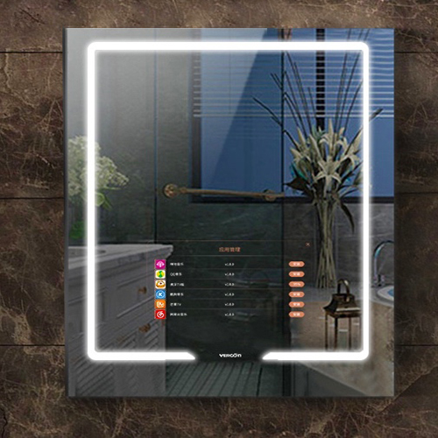
Our Project - SMART MIRROR
An interactive mirror with the added functionality of a mobile display and audio interface.

Slide 7
Objective & Application
Create a device that:
Can be used as a regular mirror
Show time and weather
Play music
Access personalized calendar.
This mirror allows for a more efficient and more interactive experience

Slide 8
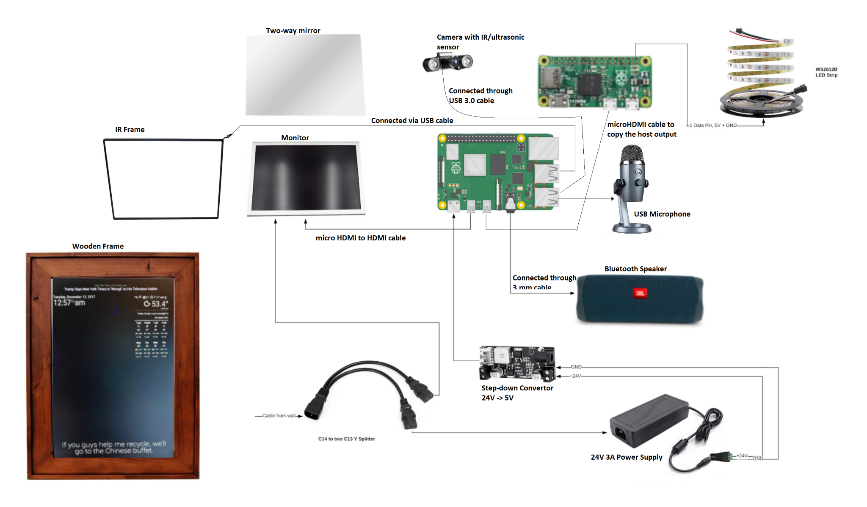
Hardware - Schematic
Components included:
Raspberry Pi 4 and Zero
24V Power Supply
Voltage Converter
Monitor
Two-Way Acrylic Sheet
IR Frame
Camera module
Speaker and Microphone
Wooden Frame and Housing

Slide 9

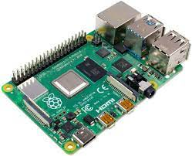
Hardware - Raspberry PI
Raspberry Pi 4B - GB
Why:
USB 3.0 for easier connection to XBox One Kinect or a camera module and others peripheral devices.
Wil run our Magic Mirror program and Gesture Recognition and Control Programs.

Slide 10
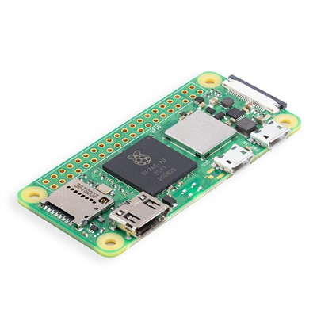

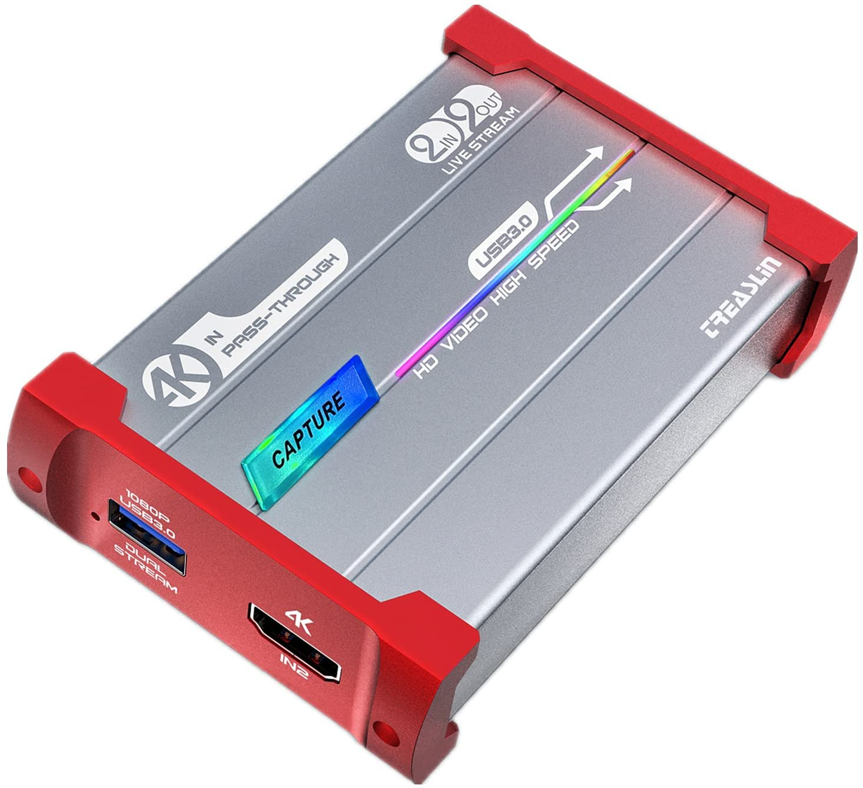
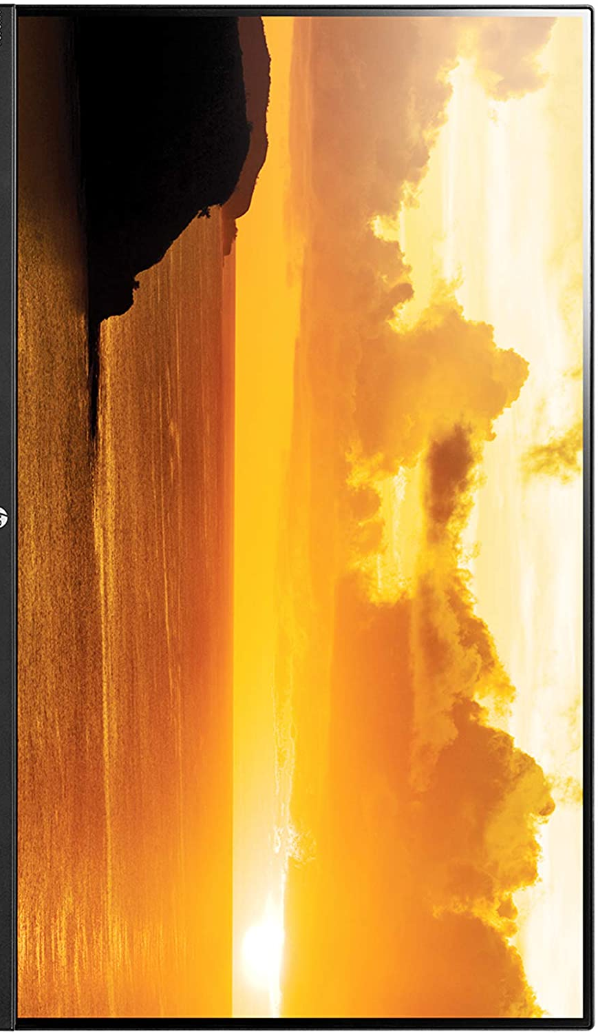
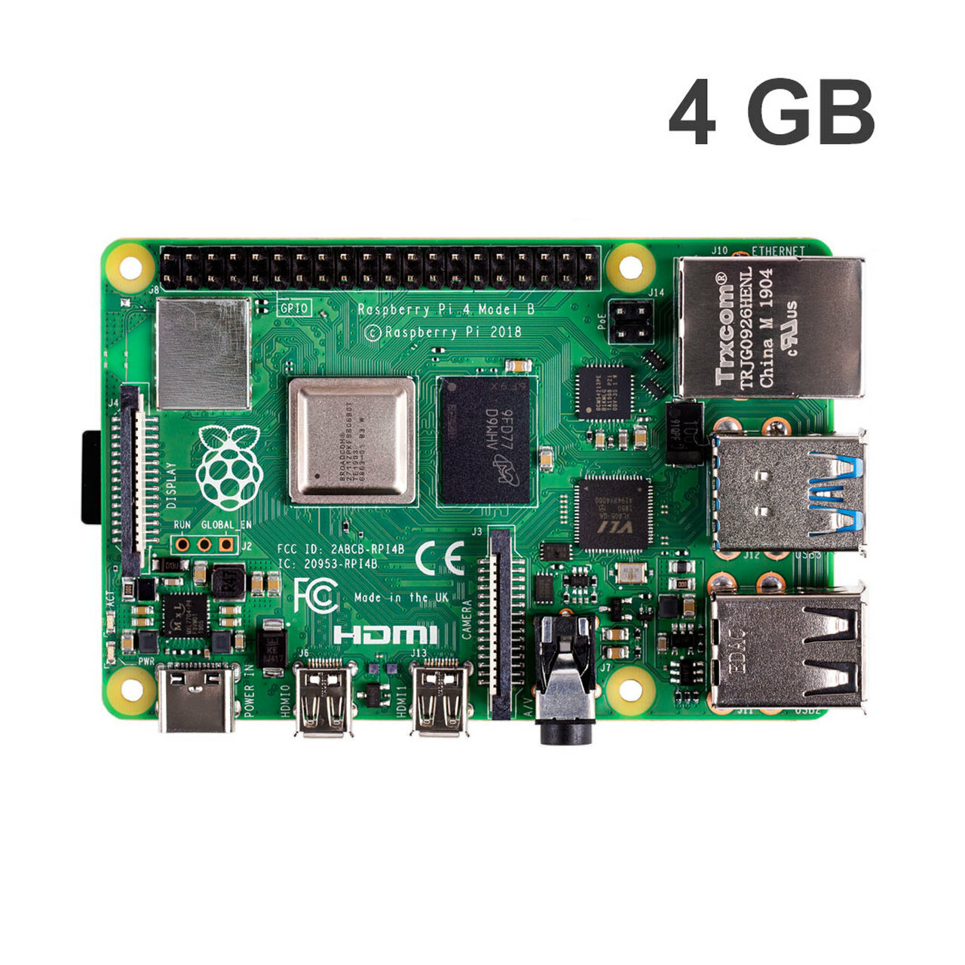
Hardware - Capture card and LEDS
Capture card: Used to split the display into monitor and Pi module
LED Module: Turns LEDs into programmable display show

Slide 11


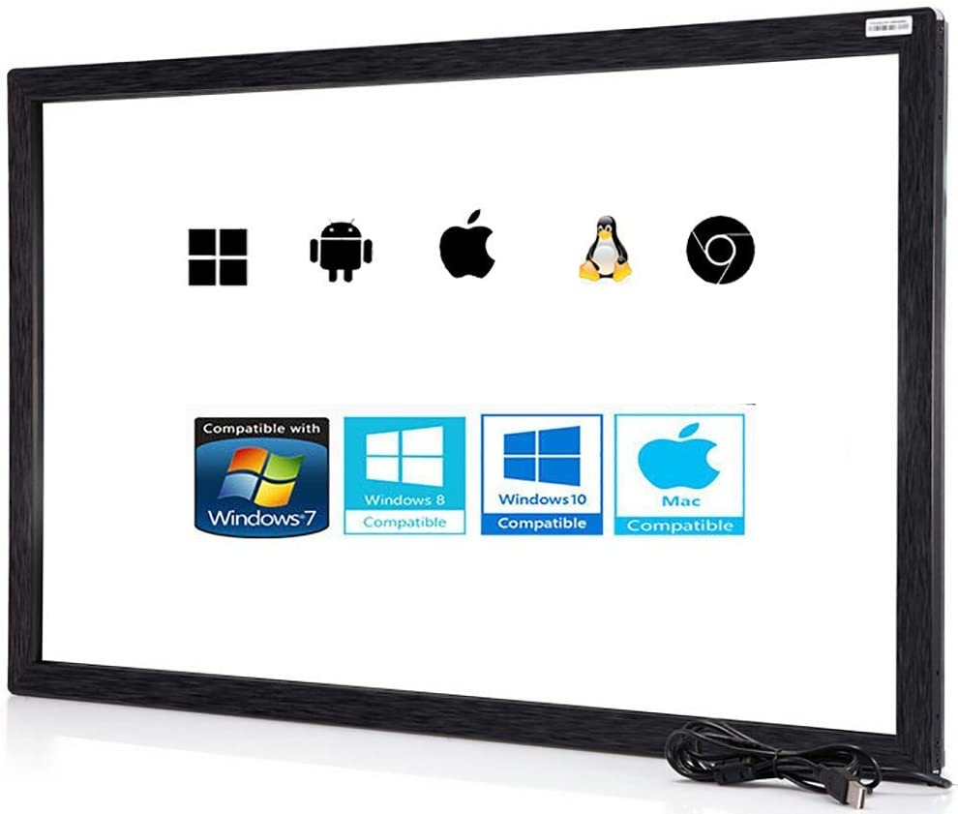
Hardware - Display
20 inch display
Allows for a greater user interface
2-Way Acrylic Film
Cheaper than glass
IR frame
Will be placed along the frame of the actual monitor and will be recognized as a mouse input.

Slide 12

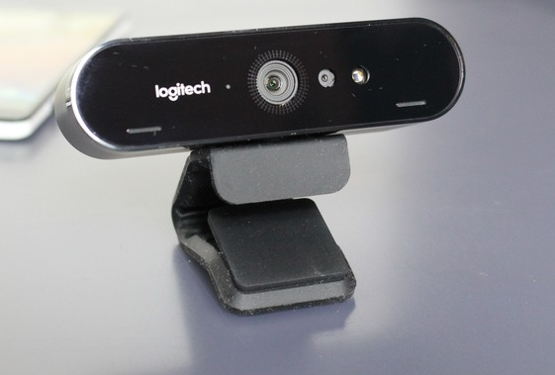
Hardware - Camera
The camera module will have an IR sensor built-in.
It will be used for the facial recognition to add or identify different users.
It will also be used to capture the gestures for the gesture controls.

Slide 13

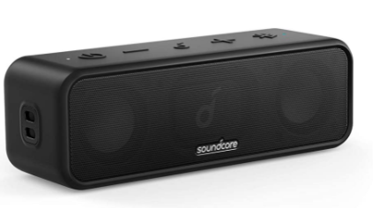
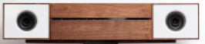
Hardware - Speaker
3.5mm Speaker Set:
-Will be used to play Alexa and Google Assistant audio as well music. Connected via the 3.5mm jack, it can also be used to connect through bluetooth.
Custom Speaker Set
-Another viable option, will be convenient, if we want to work on specific requirements for the speakers, like good bass and sound quality.

Slide 14
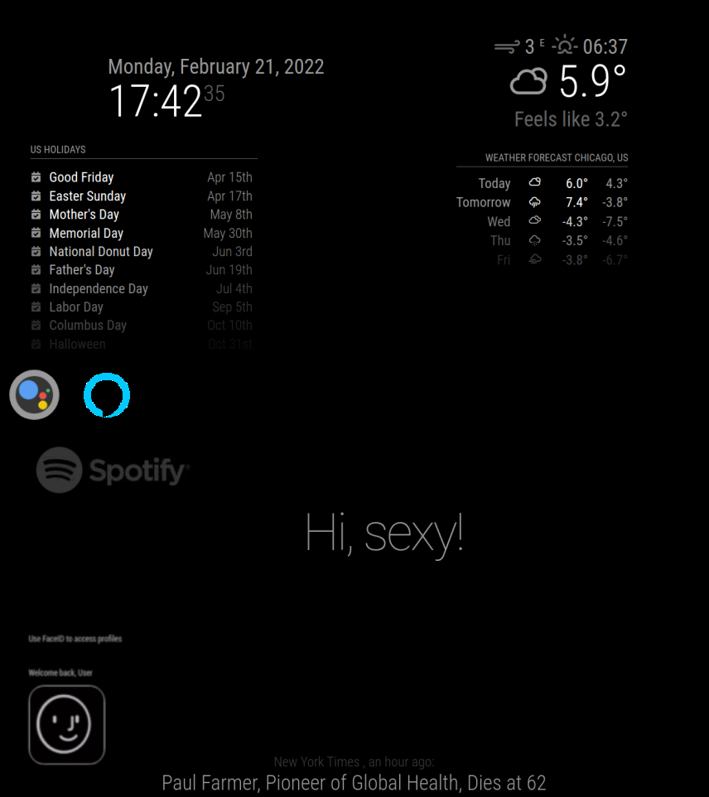
Software - Magic mirror
Magic Mirror is an open source library through which we can customize the user interface of the display with different modules.
Our primary goal is to have both Alexa and Google Assistant running on the same device.
Other features which we anticipate to include are personalized calendar, touch compatibility, gesture control, face recognition and music.
We have started working on the interface with personalized calendar, weather updates, and spotify.

Slide 15


Software - Voice Assistants
Alexa Voice Assistant:
We have started working on the AVS SDK to run on boot, but the only drawback we were facing during the research was that AVS license for wake engine got discontinued on September 2021.
We looked over the module integration on magic mirror and found a repository which uses a custom wake engine to run the Alexa voice Assistant on Magic Mirror.
Google Voice Assistant:
The Google Assistant also has a module with magic mirror which has a far higher integration with the magic mirror modules to interact with the calendar, weather, music, etc.
During the setup process for the voice assistants on the raspbian we also considered on developing our own wake engine to enable users to customize the wake word for their voice assistant.

Slide 16

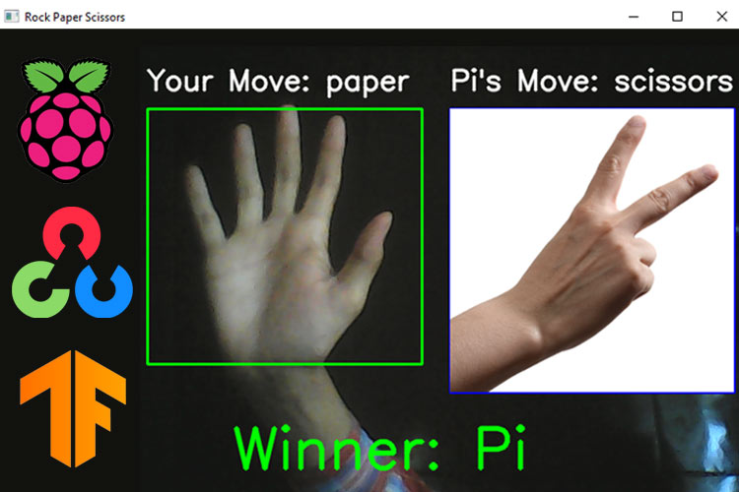
Software - OpenCV
An open source real time image processing library.
Used for gesture control
Some algorithms that can be made using OpenCV include but are not limited to:
Facial recognition
Gesture Control
Object tracking
Example of gesture recognition

Slide 17
Challenges
Voice Integration setup to enable Alexa and Google on voice command.
To run both Google Assistant and Alexa simultaneously.
To enable the assistants on magic mirror.
Setup the gesture commands on OpenCV and integrate them with magic mirror.
To work on the security aspects of the project.
To finalize the component list for purchase.

Slide 18
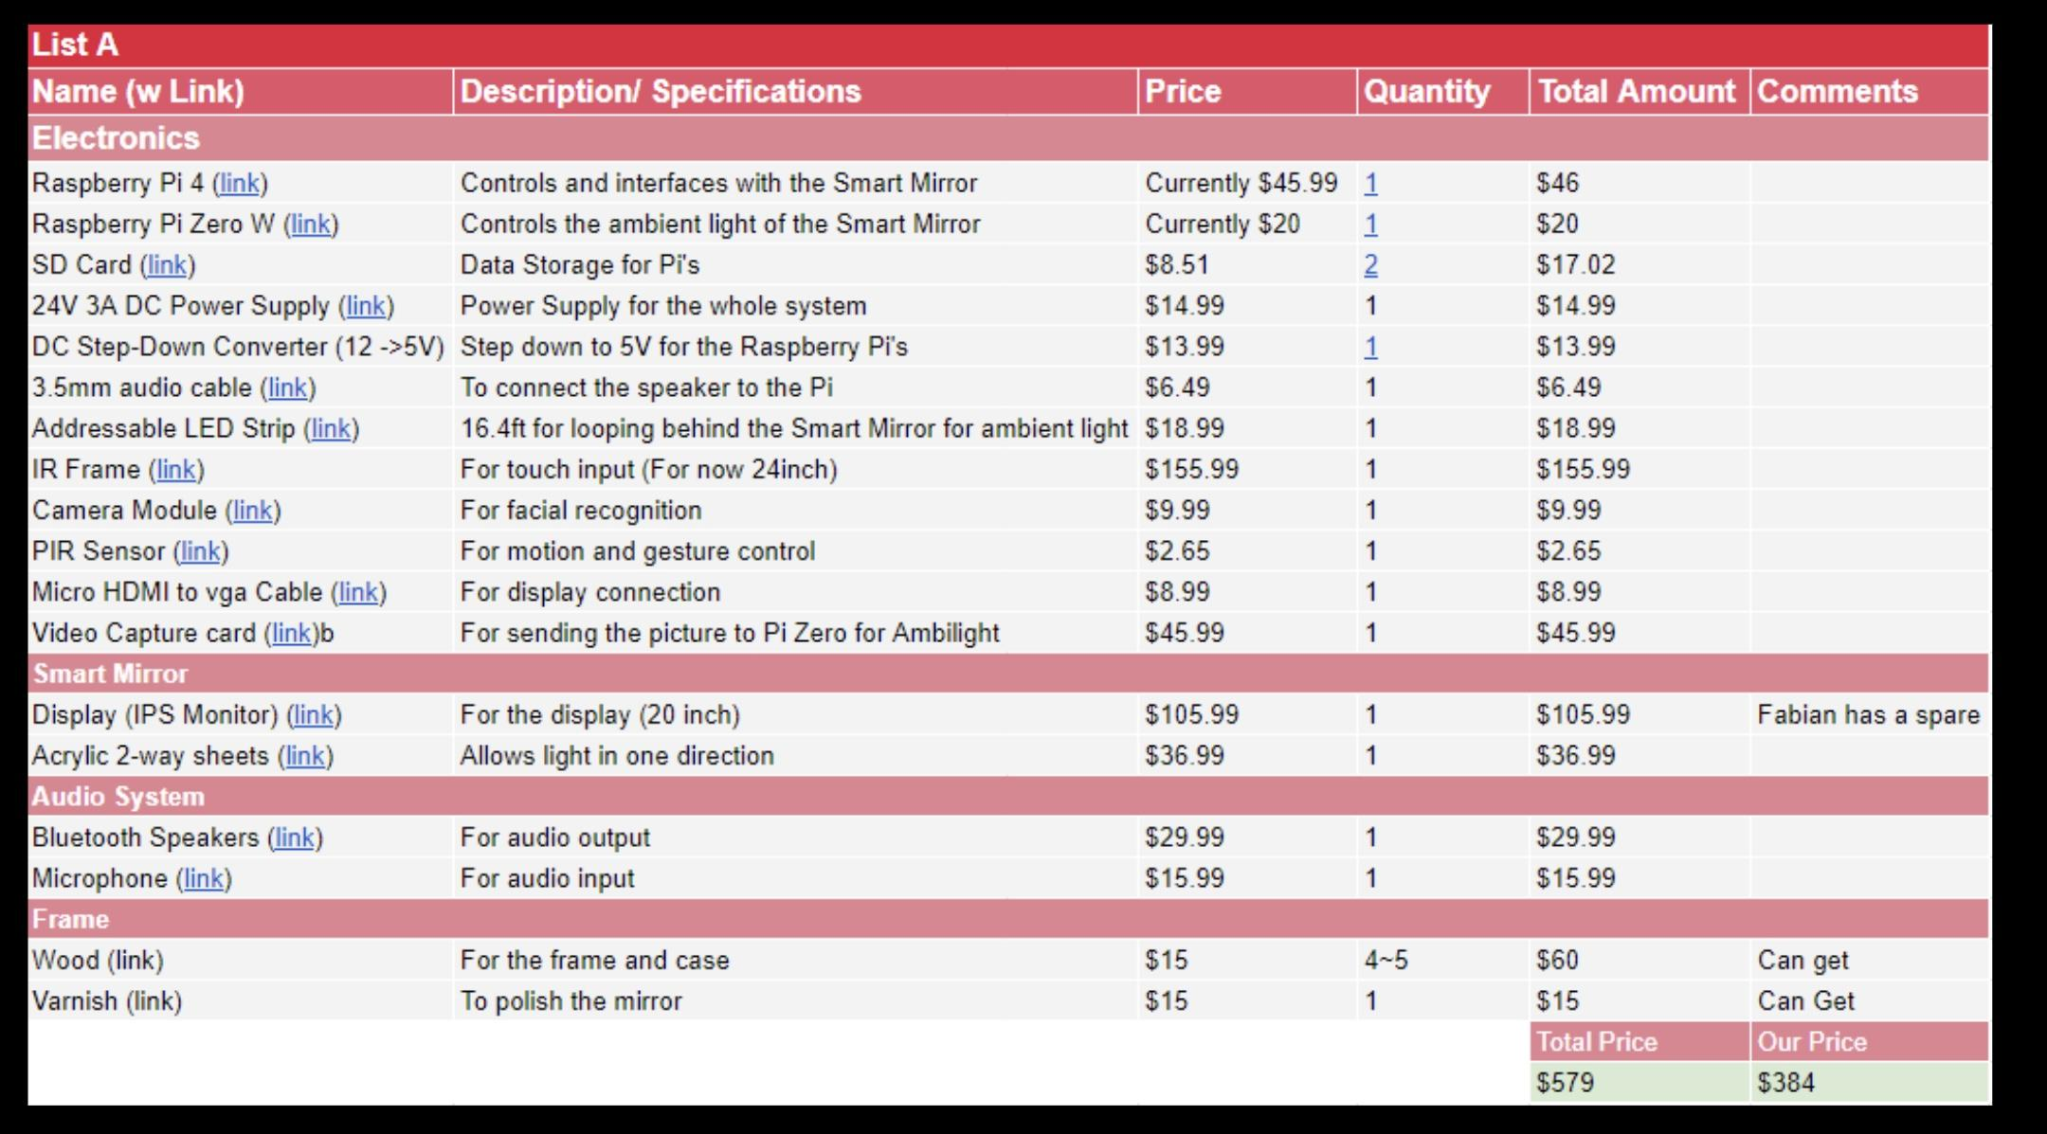
Component Cost

Slide 19
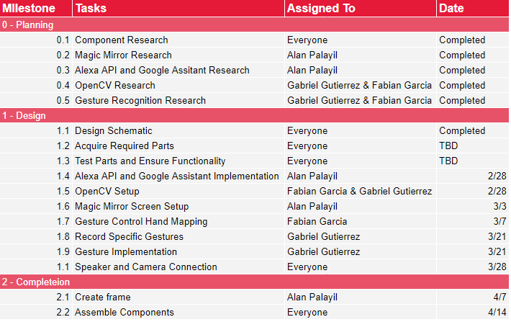
Progress and goals
Moving Forward, are plans are to begin implementing the various libraries and programs in order to piece together the complete project.

Slide 20
Demonstration

Slide 21
Questions?

Slide 22
References
Speaker icon: https://commons.wikimedia.org/wiki/File:Speaker_Icon.svg
Capture card image: https://www.amazon.com/TreasLin-Capture-Screen-Inputs-Outputs/dp/B09KBYSB91
Monitor images: https://www.amazon.com/HP-23-8-inch-Adjustment-Speakers-VH240a/dp/B072M34RQC/ref=sr_1_5?keywords=Horizontal+and+Vertical+Vertical+Computer+Monitor&qid=1645471217&sr=8-5
https://www.google.com/url?sa=i&url=https%3A%2F%2Fwww.verconmirror.com%2Fbathroom-makeup-smart-mirror-p00099p1.html&psig=AOvVaw0kaKETt9fmARDdEOur6PcM&ust=1645559407650000&source=images&cd=vfe&ved=0CAwQjhxqFwoTCMjT7dLIkfYCFQAAAAAdAAAAABAv
Raspberry Pi Image: https://www.amazon.com/Raspberry-Model-2019-Quad-Bluetooth/dp/B07TC2BK1X
Monitor Image: https://www.amazon.com/Gateway-HX2000-bmd-20-Inch-Widescreen/dp/B0028RCZV0/ref=sr_1_3?crid=XKB29H0XFNZ2&keywords=Gateway+20+inch+monitor&qid=1645473315&s=electronics&sprefix=gateway+20+inch+monitor%2Celectronics%2C74&sr=1-3
Two-Way Acrylic Film: https://www.amazon.com/0-04-Acrylic-See-Through-Mirror-Transparent/dp/B01CZ35XWY?th=1
IR Frame Image: https://www.amazon.com/Multi-Touch-Point-Infrared-Screen-Overlay/dp/B07CW9WWT5/ref=sr_1_9?crid=3A40MG9VZ8SZG&keywords=20+inch+IR+Frame&qid=1645473592&sprefix=20+inch+ir+frame%2Caps%2C71&sr=8-9

